Slide 1
Oneiros: KV Cache Optimization through Parameter Remapping for Multi-tenant LLM Serving
Ruihao Li
Feb 02, 2026

Slide 2
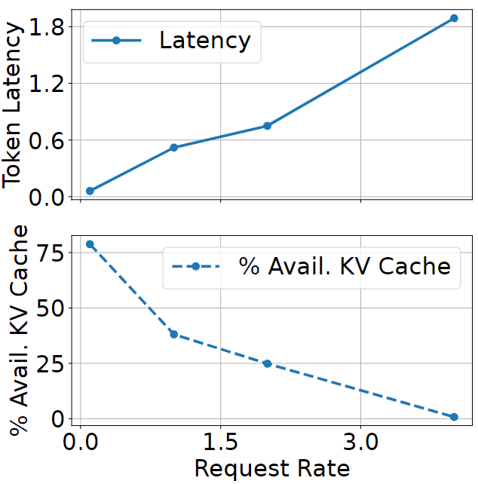
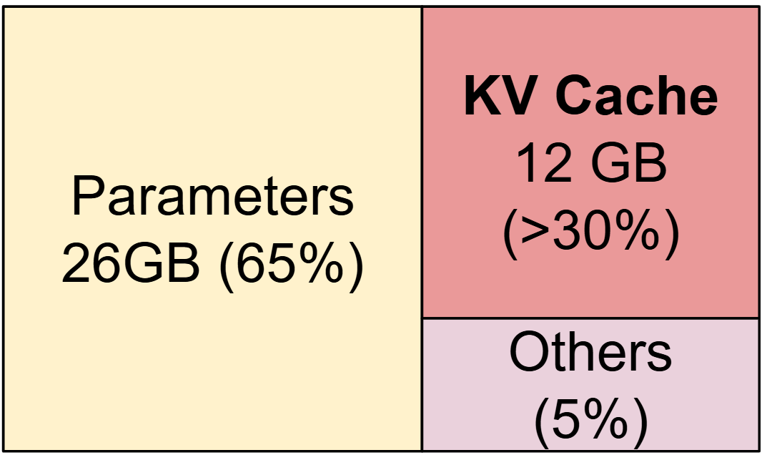
KV Cache Affects LLM Performance Significantly!
Large language models (LLMs) require enormous memory space to store not only model parameters but also their working data – KV cache.
2.5x higher!
With higher request rate (large batch size), KV cache may run out
-> high latency!
[SOSP ‘23] Woosuk Kwon et al. "Efficient Memory Management for Large Language Model Serving with PagedAttention".

Slide 3
What is LLM Inference?
Load
Model
Parameters
Embeddings
What’s your name?
Attention
Blocks
Layer Norm
Input Tokens
Q K V
Multi-Head Attention
Prefill Phase
N×
+
Layer Norm
Decode
Phase
Feed Forward
Input Tokens
+
M×
Layer Norm
Linear
Each step generates a new token util maximum sequence length or end signal
SoftMax
I am Oneiros (generated word by word)
The prefill phase executes only once, while the decode phase executes multiple times.

Slide 4
KV Cache – Specific for LLM Inference
Q K^{T} QK^{T} V Attention
What’s your name?
I
Query Token 1
Q₁,K₁
Value Token 1
Token 1
am
Query Token 2
X
=
Q₂,K₁
Q₂,K₂
X
Value Token 2
=
Token 2
Key Token 1
Key Token 2
Key Token 3
Oneiros
Query Token 3
Value Token 3
Token 3
Q₃,K₁
Q₃,K₂
Q₃,K₃
Reduces computational cost (of the decode phase) at the expense of additional memory usage.
KV cache size grows as batch size and sequence length increases!
https://medium.com/@joaolages/kv-caching-explained-276520203249

Slide 5
Existing LLM Inference Serving on GPUs
450GB/s
TB/s
(1) Load parameters to GPU memory (only once).
CPU DRAM
GPU HBM
GPU Compute
1
(2) Load input tokens to GPU memory.
Parameters
(GBs)
Parameters
(GBs)
LLM
Kernels
(3) Prefill (load inputs to GPU compute units).
Input Tokens
(MBs)
2
Input Tokens
(MBs)
3
(4)(5) Decode (KV cache transferred between GPU memory and compute units).
KV Cache
(GBs)
KV Cache
(GBs)
4
5
Output Tokens
(MBs)
7
Output Tokens
(MBs)
6
(6)(7) Send output tokens back to CPU memory.
450GB/s
TB/s
Existing LLM inference serving system did not fully utilize the CPU-GPU bandwidth
– only MB-level input/output tokens are transferred on the fly.
Use CPU memory as an extension of GPU memory to store parameters/KV cache!

Slide 6
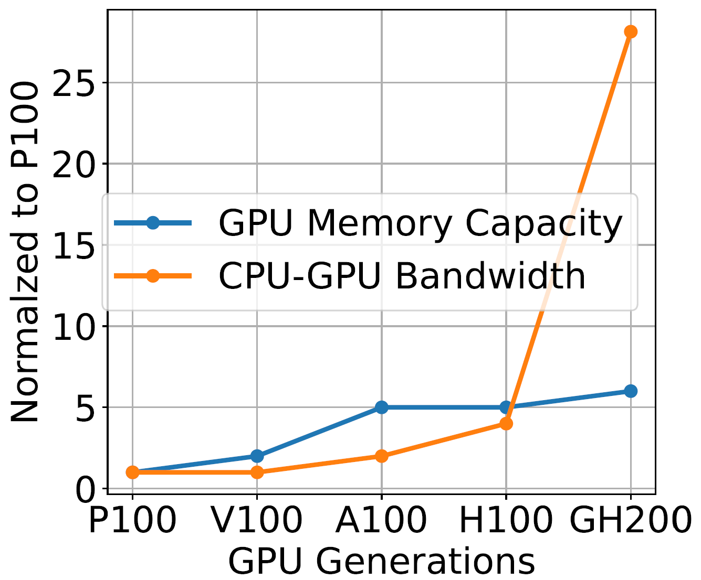
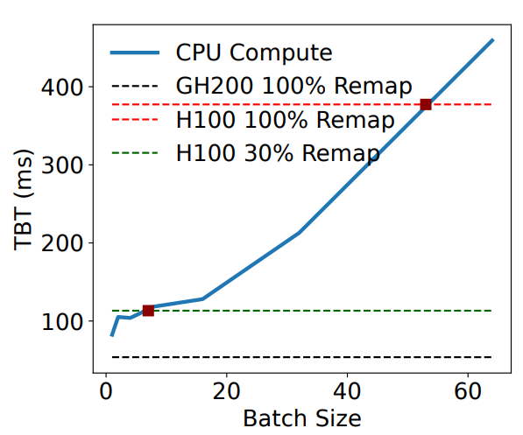
CPU-GPU Memory Bandwidth is Increasing
The CPU-GPU memory bandwidth has increased significantly with the GH200 (2023).
Trends in Nvidia GPUs
CPU-GPU transfer time vs. Offload Computation to CPUs
Use CPU memory as an extension of GPU memory to store parameters/KV cache is feasible now!

Slide 7
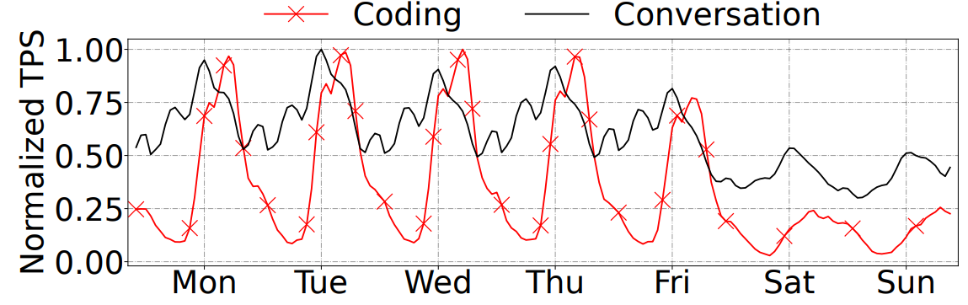
Challenges in Capacity Planning for LLM Inference Serving
LLM request arrival rates fluctuate substantially over time.
LLM both input and output sequence lengths vary as well.
Load over a week for Coding and Conversation LLM inference workloads in Azure.
It is challenging for capacity planning!
A conservative plan can leave resources idle for much of the time, while overprovisioning can still lead to KV-cache exhaustion during peak demand.
[HPCA’25] Jovan Stojkovic et al., "DynamoLLM: Designing LLM Inference Clusters for Performance and Energy Efficiency".

Slide 8
KV Cache Swapping vs. Parameter Remapping
KV Cache Swapping
Parameter Remapping
CPU DRAM
GPU HBM
CPU DRAM
GPU HBM
1
Parameters
Parameters
Parameters
Parameters
Swapped
KV Cache
2
KV
Cache
KV Cache
1
Compute Layer 1
Compute Layer 2
Reduce latency by up to 2X!
Transfer
Layer 1
Transfer
Layer 2
Remap
Effective KV Cache
Effective KV Cache
KV cache swapping requires backing up KV cache to CPU memory after each token generation
– incurs overhead due to frequent synchronization.
Parameter remapping is unidirectional with negligible synchronization overhead!
[Arxiv ‘Nov 24] Yi Xu, Ziming Mao, Xiangxi Mo, Shu Liu, and Ion Stoica, "Pie: Pooling CPU Memory for LLM Inference".

Slide 9
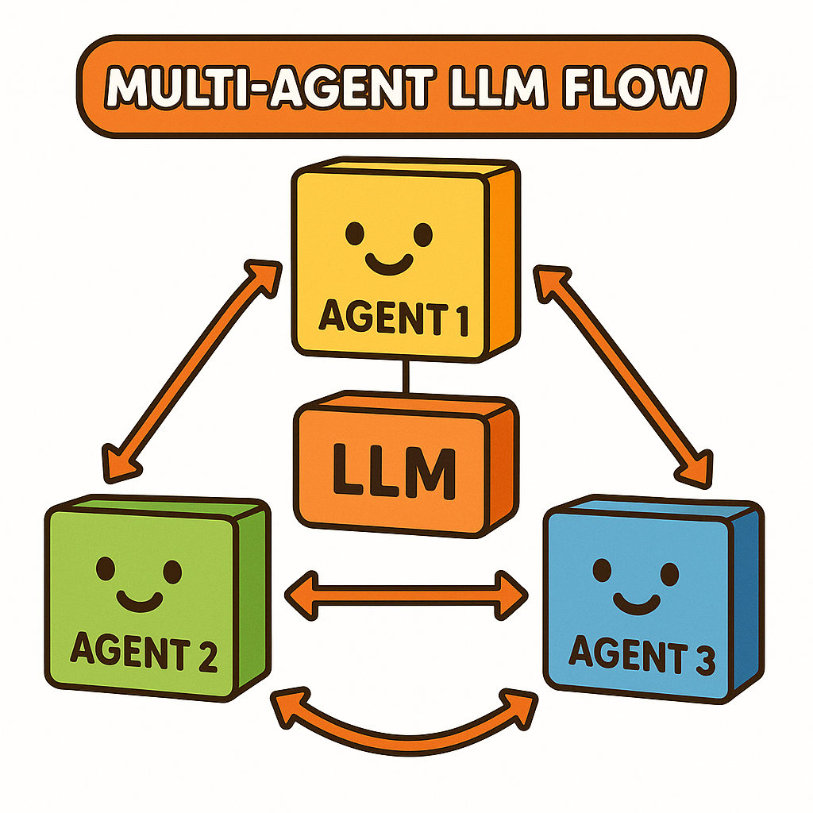
Challenges in Parameter Remapping
When to trigger remapping?
Which models to remap?
How many layers to remap?
Which layers to target?
Oneiros – dynamically remaps parameter memory to elastically resize the KV cache in multi-tenant LLM inference.
Image generated by ChatGPT (GPT-5).

Slide 10
Overview of Oneiros
Scheduler selects which models to serve.
Memory Allocator updates the memory usage (parameter and KV cache).
Remapping Controller determines whether to remap parameters.
Async Transfer Engine controls the CPU-GPU data transfer.
GPU executes the LLM inference tasks.
Scheduler
GPU
2
1
Metadata
Store
KV
Cache
3
Memory
Allocator
5
GPU Memory
Remapping Controller
4
Model
Parameters
Async Transfer Engine
5
Oneiros

Slide 11
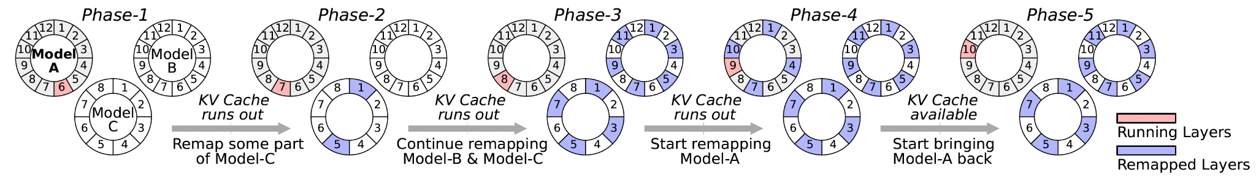
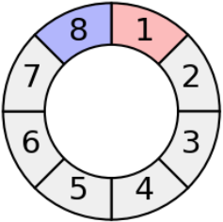
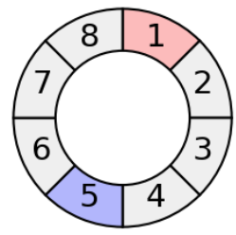
Design of Remapping Controller
When to remap?
Only when KV Cache runs out.
Compute Layer 1
Compute Layer 2
Transfer
Layer 1
Transfer
Layer 2
Which model to remap?
Prioritizing inactive models with the lowest priority (decide by the Scheduler).
How many layers to remap?
CPU-GPU data transfer should not become the bottleneck – Runtime profiler monitors the computation time.
Which Layers to Target?
A uniform-interval layer selection strategy – evenly spaced layers are chosen.
Pipeline the GPU computation and CPU-GPU data transfer.

Slide 12
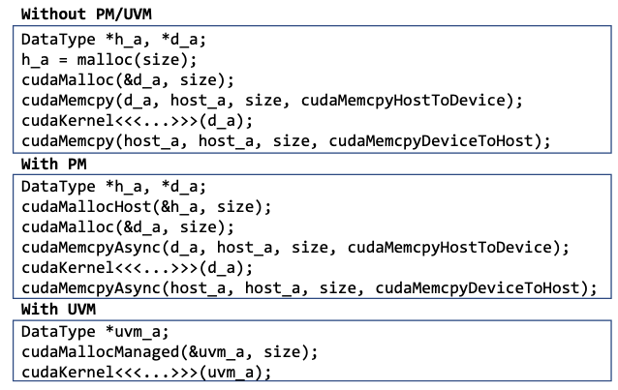
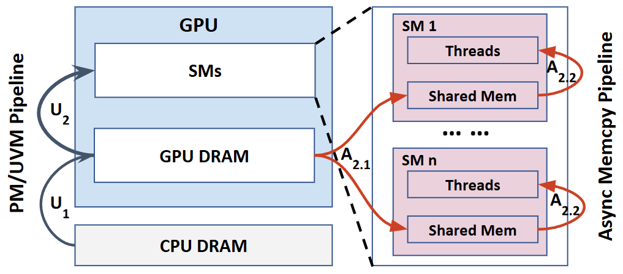
Case Study: CPU-GPU Data Transfer Techniques
Unified Virtual Memory
On-demand data transfer at per-page granularity (U₁).
Pinned Memory
Background data transfer (U₁) for running GPU kernels in parallel.
Asynchronous Memory Copy
Pipeline GPU DRAM to shared memory (A_{2.1}) with SM thread computation (A_{2.2}).
CPU-GPU system data transfer pipeline
(A_{2.1} and A_{2.2} present zoomed-in views of U₂).
[ACM TACO’25] Ruihao Li et al., "Performance Implications of Pipelining the Data Transfer in CPU-GPU Heterogeneous Systems".

Slide 13
Overview of Workloads
Suites | Source | Program Name | Description
Microbenchmark | Svedin et al. | vector_seq | Vector-to-Constant
 |  | vector_rand
 | PolyBench | saxpy | Vector-to-Vector
 |  | gemv | Matrix-to-Vector
 |  | gemm | Matrix-to-Matrix
 |  | 2DCONV | Used gemm
 |  | 3DCONV
Real-world Applications | Rodinia | LavaMD | 6 most representative workloads
 |  | NW
 |  | Kmeans
 |  | Srad
 |  | Backprop
 |  | Pathfinder
 |  | HotSpot | Workloads used in Svedin et al.
 |  | LUD
 | UVMBench | bayesian | Additional workloads, others covered in PolyBench and Rodinia
 |  | KNN
 | Darknet | Resnet18 | ML workloads implemented in C++, easy for profiling
 |  | Resnet50
 |  | Yolov3-tiny
 |  | Yolov3
7 Microbenchmarks
14 Real-world Applications
https://github.com/UT-LCA/UVMAsyncBench/

Slide 14
Experimental Setup
Machine Configurations (4 machines)
Machine-A: A100 + Intel Ice Lake + DDR4 + PCIE 3.0
Machine-B: A100 + AMD Milan + DDR4 +PCIE 4.0
Machine-C: A100 + Intel Sapphire Rapids + DDR5 + PCIE 4.0
Machine-D: H100 + AMD Genoa + DDR5 + PCIE 5.0
UVM, PM, and Async Memcpy Configurations (6 configurations)
baseline (standard cudaMalloc, cudaMemcpy APIs; without UVM, PM, or Async Memcpy).
async (using Async Memcpy only).
uvm (using UVM only).
uvm_async (using UVM and Async Memcpy).
pm (using PM only).
pm_async (using PM and Async Memcpy).

Slide 15
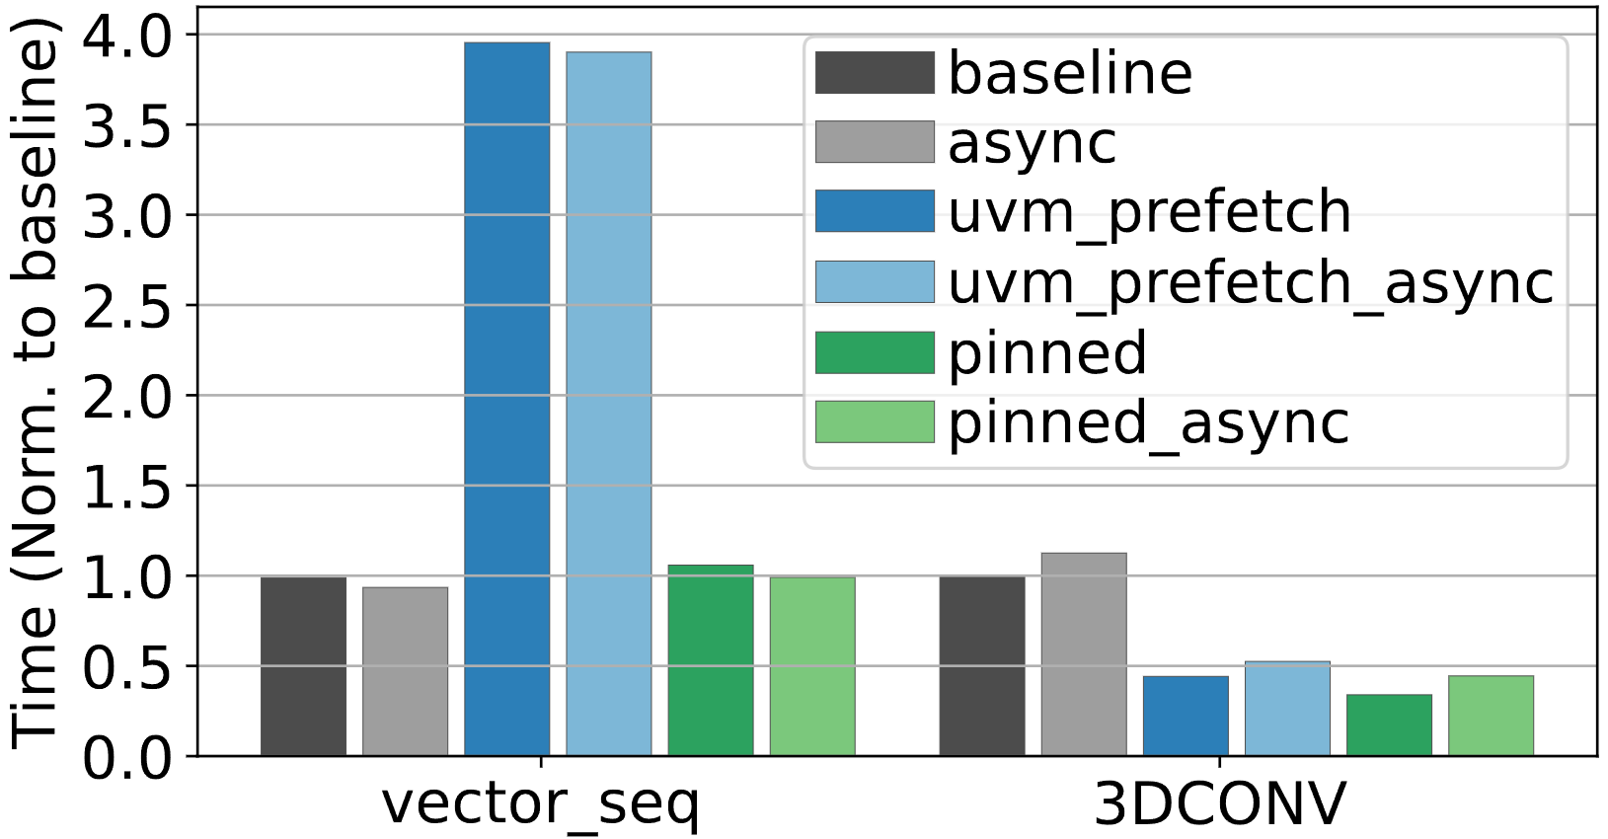
CPU-GPU Data Transfer Critically Impacts Performance
Performance of different memory management mechanisms in CPU-GPU systems (AMD Zen3 + A100).
baseline – standard (legacy) data transfer
async – Async Memcpy
uvm – Unified Virtual Memory
uvm_async – UVM + Async Memcpy
pm – Pinned Memory
pm_async – PM+ Async Memcpy
More than 4X performance difference.
No single data transfer mechanism is optimal across all workloads.
[ACM TACO’25] Ruihao Li et al., "Performance Implications of Pipelining the Data Transfer in CPU-GPU Heterogeneous Systems".

Slide 16
Oneiros Evaluation Setup
Baselines
vllm (v 0.7.3)
Pie (KV Cache swapping)
Datasets
Alpaca
ShareGPT
Traces
Azure LLM inference coding traces
Metrics
Time-to-first-token (TTFT) latency
Time-between-token (TBT) latency
Throughput (tokens / s)
Machine Configurations (GH200)
CPU |  | 72 x Arm Neoverse V2
DRAM |  | 224GB LPDDR5X
GPU |  | H200
HBM |  | 96GH HBM3
Model combinations with GPU memory reservations
C1 |  | OPT-13b (35%), Lllma-2-13b (35%), Lllma-3-8b (20%)
C2 |  | OPT-30b (65%), OPT-6.7b (15%)

Slide 17
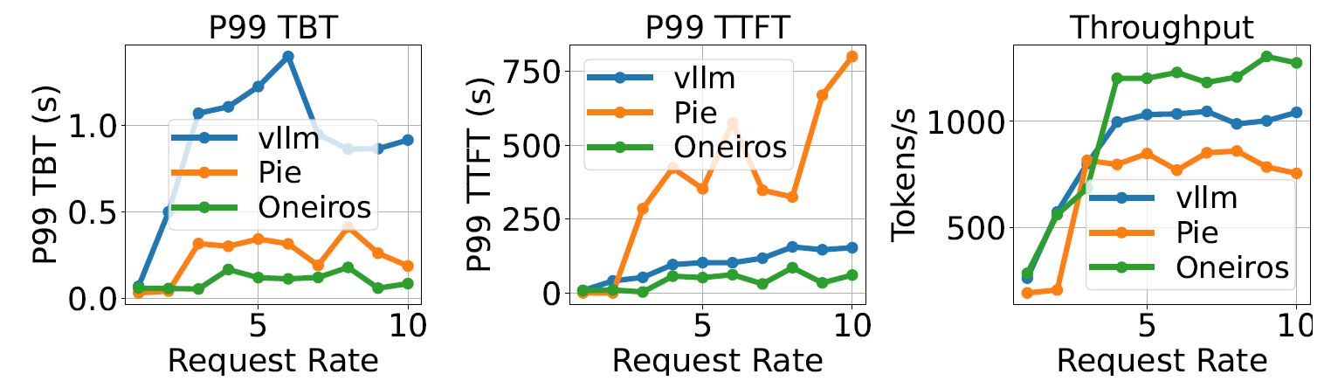
Oneiros vs. vllm & Pie
Oneiros reduces latency and improves throughput compared with Pie.
Avoid the overhead of backing up KV cache to CPU memory.
Lower is better
Higher is better
Serving the OPT-13b model using the Alpaca dataset.
[Arxiv ‘Nov 24] Yi Xu, Ziming Mao, Xiangxi Mo, Shu Liu, and Ion Stoica, "Pie: Pooling CPU Memory for LLM Inference".

Slide 18
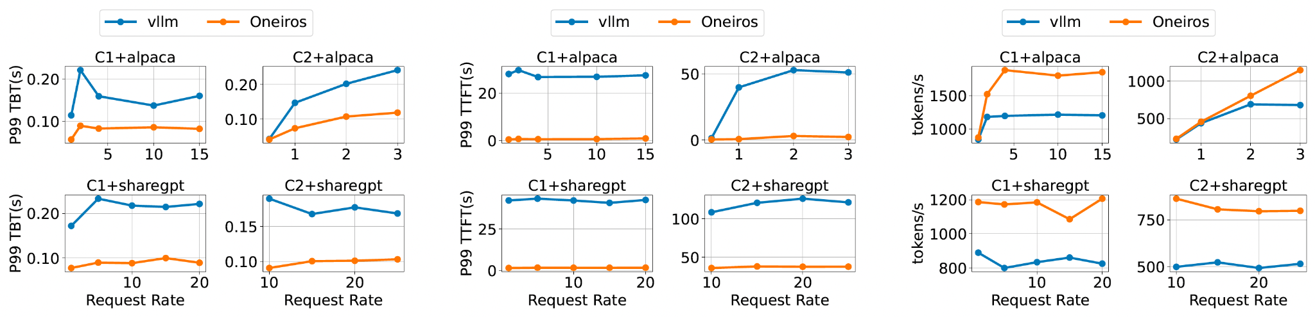
Oneiros vs. vllm
Oneiros reduces latency and improves throughput compared with vllm on both C1 and C2.
Oneiros reduces tail TBT latency Oneiros reduces tail TTFT latency Oneiros improves throughput

Slide 19
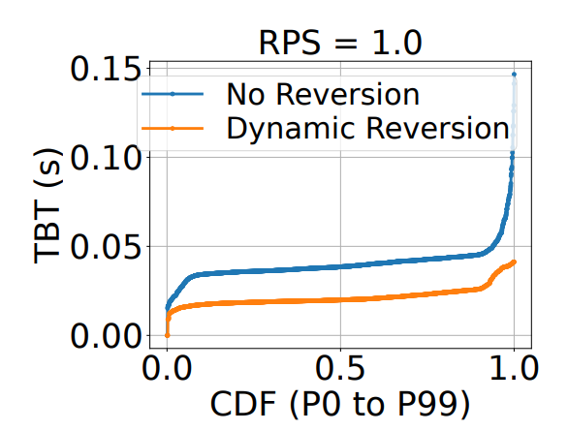
Oneiros Design Choices
Oneiros makes the correct decision of “when to start/stop remap”.
Compared with continuous remapping (No Reversion), pausing remapping during low-load periods (Dynamic Reversion) is necessary to avoid Oneiros-induced overhead.
CDF of TBT – Serving the OPT-13b model using the Alpaca dataset.

Slide 20
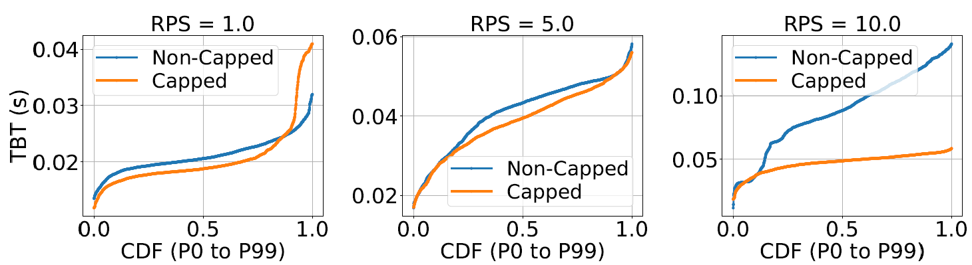
Oneiros Design Choices
Oneiros makes the correct decision of “how many layers to remap”.
Compared to remapping as many layers as possible (non-capped), capping the maximum number of remapped layers yields more balanced performance.
CDF of TBT – Serving the OPT-13b model using the Alpaca dataset.

Slide 21
Summary
Emerging hardware platforms provide increasingly higher CPU-GPU bandwidth.
Existing solutions to use CPU memory as an extension for GPU memory – KV Cache swapping – incur significant overhead due to the bidirectional data transfer.
Oneiros: KV Cache Optimization through Parameter Remapping for Multi-tenant LLM Serving
Dynamically remaps parameter memory to elastically resize the KV cache.
Mechanisms to control when to trigger remapping, which models to remap, how many layers to remap, which layers to target.
Thank you
Q & A
Ruihao Li liruihao@utexas.edu
https://github.com/UT-SysML/Oneiros/
Notes:
Think of short of time -> I talk about Oneiros about xxxx, I am happy to take questions.

